Slide 1
EGR 1400
Computer Problem Solving in
Engineering and Computer Science
Laboratory Experiment #4
A Computerized Game : Craps

Slide 2
The Game
Dice Game
Played in many casinos
Bet on outcome of dice roll
We will simulate the “pass line” bet

Slide 3
Pass Line bet
“Come out” roll
  First roll of the game
  Player wins if roll is 7 or 11
  Player loses if 2, 3, or 12
  Other totals result in establishing the point

Slide 4
Subsequent Roll
Try to roll the Point before you roll a 7
All other dice totals don’t count

Slide 5
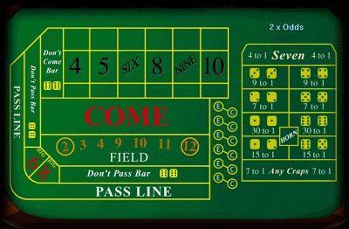
OFF

Slide 6


OFF
Winner

Slide 7

OFF
Winner

Slide 8
OFF
Loser

Slide 9

ON
OFF

Slide 10
ON

Slide 11
ON

Slide 12

ON
OFF
Loser

Slide 13

ON
OFF

Slide 14
ON

Slide 15
ON
OFF
Winner

